Slide 1
Introduction

Slide 2
Using Career Planning and Discovery to Jump Start the Job Search
May 15, 2025
Work in Progress: Employment and Community Life Conference

Slide 3
Instructors
Jill Eastman, M.A., CESP
Program Coordinator
Employment & Training
Institute for Community Inclusion
Jill.eastman@umb.edu
Beth Wike, M.A.
Training Associate
Institute for Community Inclusion
Elizabeth.wike@umb.edu

Slide 4
Session Goals
Identifying and describing core components of Career Planning
Person-centered planning
Building the team
The Power of Discovery
Building YOUR Toolbox
Positive Personal Profile
Charting the LifeCourse
30 Day Job Development Plan
Arranging and facilitating work-based learning experiences
Networking for Opportunities and Resources
Planning for Success

Slide 5
Quality career planning is based on job seeker’s interests and desires, not just on what they “can do”!

Slide 6
Learning from Carly
Notes:
https://www.youtube.com/watch?v=F4XMlhCfp3Q

Slide 7
Career Planning: Foundation
Build the Team | Develop Vocational Profile | Develop Placement Plan
Family, friends, professionals, employers | Interests and skills | Tasks
Contribution to the process | Past experiences | Roles and Responsibilities
Role of the job seeker | Identify employment goal/outcome | Timeframe
Role of the Employment Specialist | Methods and Tools | Review and Revise

Slide 8
Language Matters
Strengths vs. Deficits

Slide 9
Customizing Communication
Identify preferred communication style and patterns
Use accommodations and tools to support communication
Scripts
Pictures
Photos
Assistive Technology

Slide 10
Communication Skills
Active Listening
Effective Questioning and Paraphrasing
Confrontation, Negotiation, and Resolution

Slide 11
A Word from Denise Bissonnette
Gifts and Possibilities
Notes:
https://www.youtube.com/watch?v=DNQqd_PRKdY

Slide 12
Getting to Know the Job Seeker

Slide 13
What if you still need more information?
You have asked all the right questions
You met with the job seeker several times
But remain unsure of good job matches and/or job tasks

Slide 14
Discovery
Interviews
Observation
Time in the Community
Records Review
Documentation
Notes:
​

Slide 15
Being Person-Centered
Treating people with dignity and respect
Using personal strengths and talents as foundation to build upon
Supporting people in connecting to their community
Listening and acting on what the person communicates
Taking time to know and understand individuals and the things that make them unique

Slide 16
Person-Centered Planning
A process for determining desired outcomes alongside a person based on their strengths, interests, values and needs
Directed by the job seeker
Flexible
A Living Document
Facilitates choice
Strengths based vs Deficit-based
Person vs Program-centered

Slide 17
Person-Centered Thinking leads to Person-Centered Planning

Slide 18
Positive Personal Profile
Inventory of attributes relevant to the entire employment process
Pulls together information learned from variety of sources
Supports building of resume, interview preparation and finding the best fit for role and environment

Slide 19
Components of the Personal Profile
Dreams & Goals
Interests
Talents, skills & knowledge
Learning styles
Values
Positive personality traits
Cultural background & beliefs
Environmental preferences
Dislikes
Life & work experience
Support system
Specific needs
Innovative solutions & accommodations
Creative possibilities & ideas!

Slide 20
Personal Profile vs IEP/ISP Process
Personal Profile
Job seeker drives the process
Job seeker chooses team members to participate
Focus: strengths, vision, interests
Holistic approach to resources
Informal and formal supports
IEP/ISP
Treatment team drives process
Treatment team with or without individual
Focus: diagnosis, deficits, challenges
Disability specific resources
Formal and paid supports

Slide 21
Integrating ISP Goals into Employment Planning
How can career planning activities help work towards meeting ISP goals?
Safety and travel
Communication/soft skills
Grooming and hygiene
Organizational skills

Slide 22
Sample Positive Personal Profile

Slide 23
Charting the LifeCourse
All people have the right to live, love, work, play and pursue their own life aspirations
Key Principles:
Focus on ALL
Recognize the person in the context of the family AND community
Trajectory of life experiences
Achieving life outcomes

Slide 24
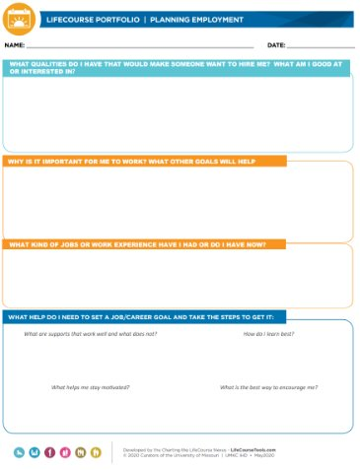
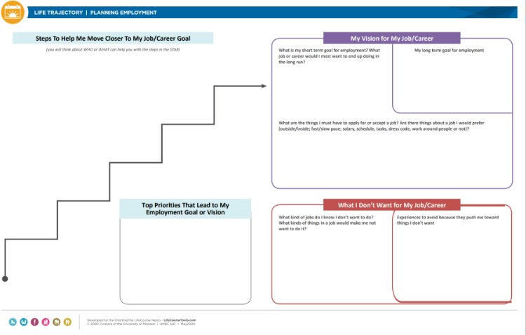
Charting the LifeCourse & the Employment Portfolio
Integrated Supports Star
Planning Employment
Life Trajectory

Slide 25
Life Trajectory Planning for Employment

Slide 26
Integrated Support Star for Employment
Identifies existing resources –AND – what else is needed
Drives outside-of-the-box thinking
Facilitates development of natural supports
Strengthens problem solving and future planning

Slide 27
Pulling it all together: Summary

Slide 28
Remember….
It’s a journey, not a sprint!
What works for one person…
Be flexible and open-minded
Be willing to learn/try something new
Embrace change

Slide 29
Assessment
“A pity this test doesn’t measure all her skills…”

Slide 30
Effective Career/Job Exploration Approaches
Work-Based Learning (WBL) Opportunities​
Informational Interviews, Tours, Job Shadows​
Situational Assessments (On-the Job Evaluation)​
Skills Training and Classes​
Mentoring​
Employer and Vocational Research​
Volunteering

Slide 31
Work-Based Learning A Good Fit…
Limited work or community experience
Interests needing further exploration
Interested in changing careers or jobs
Job/career/environment
assessing for “fit”
Needing opportunities to demonstrate abilities or interest to employer

Slide 32
Informational Interviews
Explore careers, specific work settings, clarify goals
Expand professional networks
Build confidence in job interviewing
Receive up-to-date career information
Identify professional strengths and weaknesses
Learn about business needs and goals
Get feedback on resume

Slide 33
Business Tours
Expose job seeker to work environment
Opportunity to learn more about the job seeker, employers, and careers
Practice self-presentation skills in low stress situation

Slide 34
Job Shadowing
Opportunity to experience actual job and environment
Try to observe multiple roles and more than one person performing job tasks
Time limited
Ask more specific questions
Learn more than in an informational interview

Slide 35
Volunteering
Unpaid activities
Non-profit organizations only
Open to all individuals
Based on individual's preferences, interests and goals
Self-determination and choice
Not just to stay busy or fill time
Not a long-term substitute for paid employment

Slide 36
On-the-Job Evaluation/ Job Tryout
Examine skills and abilities
Try accommodations/support strategies
Explore career/job options or work environments
Look at social skills/interactions, work habits, learning styles
Opportunity for job seeker to work in community setting and try job or related tasks.
Notes:
​

Slide 37
On-the-Job Evaluation: Considerations
Involve supervisors and co-workers
Try a variety of tasks
Explore both:
Requirements of job/tasks
Ability to meet requirements/expectations
Use a standard format to collect information
Vary work trial hours and times
Examine task and non-task areas
Work culture and opportunities for natural supports & social inclusion

Slide 38
Financial and Legal Considerations Unpaid Work Experiences
Disability
Vocational exploration, assessment or training
Individualized Plan for Employment
No immediate advantage to employer/business
Time limitations per activity
No guarantee of employment

Slide 39
Skills Training and Vocational Classes
Learn new skills
Identify likes & dislikes
Receive up-to-date career information
Make networking contacts/new connections

Slide 40
Mentoring
What is a mentor?
A more experienced professional (in your field) who offers you career guidance, advice and assistance from a real-world point of view
Why should someone have a mentor?
Gain knowledge and hear about factors for success
Get assistance with setting and achieving goals
Make smart business decisions
Overcome workplace challenges
Learn new skills
Build new networks

Slide 41
Employer and Career Research
Resources:
America’s Job Centers (MassHire)
Pathful Explore (Virtual Job Shadow)
Occupational Information Network (O*NET)
Social Media (LinkedIn, Facebook, Instagram, X)
Information Needed:
Local labor market trends
Job requirements and environments
Level of education and experience needed
Availability of jobs

Slide 42
“Networking is not about just connecting people. It’s about connecting people with people, people with ideas, and people with opportunities.​”
Michele Jennae,
Consultant, Writer, Artist

Slide 43
Tap into YOUR Networks!
Personal/
Professional
Early Childhood
Services Used
Associations
Spiritual/Worship
Organizational/
Agency-Wide
Health & Wellness
Community Based
Retail
Establishments

Slide 44
Identifying Support Needs
Potential support needs and barriers must be identified and addressed for long-term employment success
Two Areas of Focus:
Accomplishing job tasks
Fitting in with the work culture

Slide 45
Think About and Plan for…
Transportation
Benefits Management
Personal Organizational Skills
Non-work Appointments
Accommodations/AT
Financial Management
Clothing/Uniform
Housing
Child Care

Slide 46
Addressing Support Needs
Assist with finding and accessing resources
Identify and arrange accommodations
Placement support resources
Recognize and facilitate natural supports
Fading supports & social inclusion

Slide 47
Natural Supports
Assistance in the workplace typically available and/or perceived as usual
Non-paid supports
Utilize existing workplace supports and strategies to train and mentor
Job coach may facilitate natural supports

Slide 48
Benefits Planning
Why:
Supports independence
Promotes financial independence
Long term benefits may mean living below poverty level
How:
Certified Work Incentive Counselors (CWIC)
Work without Limits
Notes:
​

Slide 49
Transportation
First: “Typical” options: public transit, carpool
Next: Para-transit: The Ride, ride share, hiring a driver
Last: Service provider, short term, drains resources
Consider transportation early in the career planning process:
Build a resource directory
Keep job seekers involved
Develop good relationships with local transit officials
Avoid “yes, but transportation is too much work.”
Stay positive

Slide 50
Pulling it All Together
Striving to do your best for everyone you work with means managing many variables at the same time.
Stay organized. Planning is the best way to stay on top of the to-dos on your list.
Use a 30-Day Job Development Plan to help keep you, the job seeker, and stakeholders on the same page

Slide 51
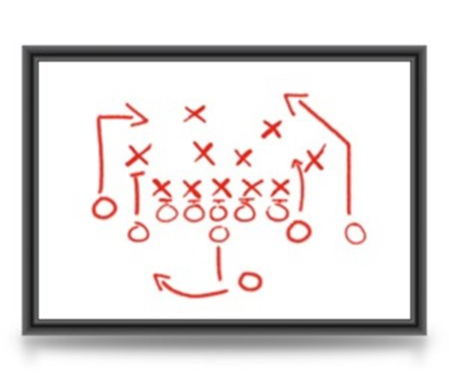
Creating Plans
A 30-Day Job Development Plan is an agreement between the job seeker, employment specialist and others to identify and accomplish tasks and action-steps needed to reach the goal of securing a quality job match.
Notes:
​

Slide 52
30-Day Job Development Plan Organize the job search tasks, responsibilities and timeliness
Keeps the job seeker motivated and involved​
Provides a sense of accomplishment even if a job has not been secured yet​
Puts the job seeker in control of the process

Slide 53
Job Seeker’s Tasks
Bring in interesting job postings/ideas
Bring in application forms
Talk to friends and family about their job goals
Develop questions to ask the employer on an interview
Make a list of things they are proud of (or what makes them unique)

Slide 54
Employment Staff Tasks
Contact employers
Help job seeker create cover letter and resume
Assist job seeker in targeting specific employers
Call the job seeker’s references and past employers for feedback
Keep team on track, moving forward

Slide 55
Team Member Tasks
Conduct practice interview with job seeker
Help job seeker review job postings
Contact networks on job seeker’s behalf
Explore different types of work with job seeker

Slide 56
Updating the 30-Day Plan
If a job is found, write a new plan to include supports after hire
If a job isn’t found, update plan and include new strategies and steps for job development
If something planned isn’t accomplished, find out why and include follow-up in new plan
Seek out and listen to the job seeker’s thoughts about their tasks throughout the process

Slide 57
Important Points to Remember
Begin every 30-Day plan with a person-centered approach
Assign tasks to team members according to their strengths and areas of expertise
A 30-Day plan is for ALL job seekers
30-Day plans should be reviewed and rewritten every 30 days until the job seeker obtains employment and transitions well into their new position

Slide 58
Documentation
Your case notes, time logs, reports, planning documents, etc., all paint a picture of individual support services, and become part of the official file to be reviewed by CARF (and others…)
Timely
If handwritten, legible
Complete sentences, with complete thoughts
Objective vs opinions/subjective
Specifics: date, what you did, how it went, observations, next steps

Slide 59
Summary
Use non-traditional assessments for career development
Use whatever works to draw out job seeker expression of strengths, skills, interests and preferences
Many resources available for career exploration and job search
Plan for short- and long-term support
Time and energy spent on good, effective career planning is very worthwhile!

Slide 60
Thank You!

